Slide 1
IBM Hackathon- 2020
Covid-19 Twitter Sentiment Analysis

Slide 2
Introduction
Twitter is a popular microblogging service where users create status messages (called "tweets"). These tweets sometimes express opinions about different topics. Due to the outbreak of CoronaVirus, twitter has become a popular platform to express individuals' views on the current scenario.
The purpose of this project is to build an algorithm that can accurately classify Twitter messages as positive, negative or neutral, with respect to a query term. Our hypothesis is that we can obtain high accuracy on classifying sentiment in Twitter messages using machine learning techniques.

Slide 3
Problem Statement
Gathering and analysing the reaction of a country's population to various events occuring in the country requires a lot of time and space without proper visual aids.
Going through billions of reactions will require a large amount of time and hence is impossible to be done by humans.
The data has to be collected, sorted, analysed and classified based on the sentiment. The result after analysis will be impossible to understand without proper visualization techniques.

Slide 4
Solution
The solution to massive data gathering and analysis comes in the form of various data science techniques and machine learning algorithms which can work on TeraByte range data within seconds.
The proposed solution deals with the various phases in sentiment analysis using algorithms and hence minimal human intervention.
Computer systems are capable of storing and processing large volumes very easily compared to a human being.

Slide 5
Block Diagram
Data Sorting
Data Cleaning using NLP
Data Extraction
Data Analysis
Sentiment Prediction
Data Linking
Graph Production
Graph Updation
DATA INPUT AS TWEETS
DATA OUTPUT AS GRAPHS
DATA ANALYSIS
DATA VISUALIZATION
Deployed On IBM Cloud

Slide 6
UI Demonstration

Slide 7
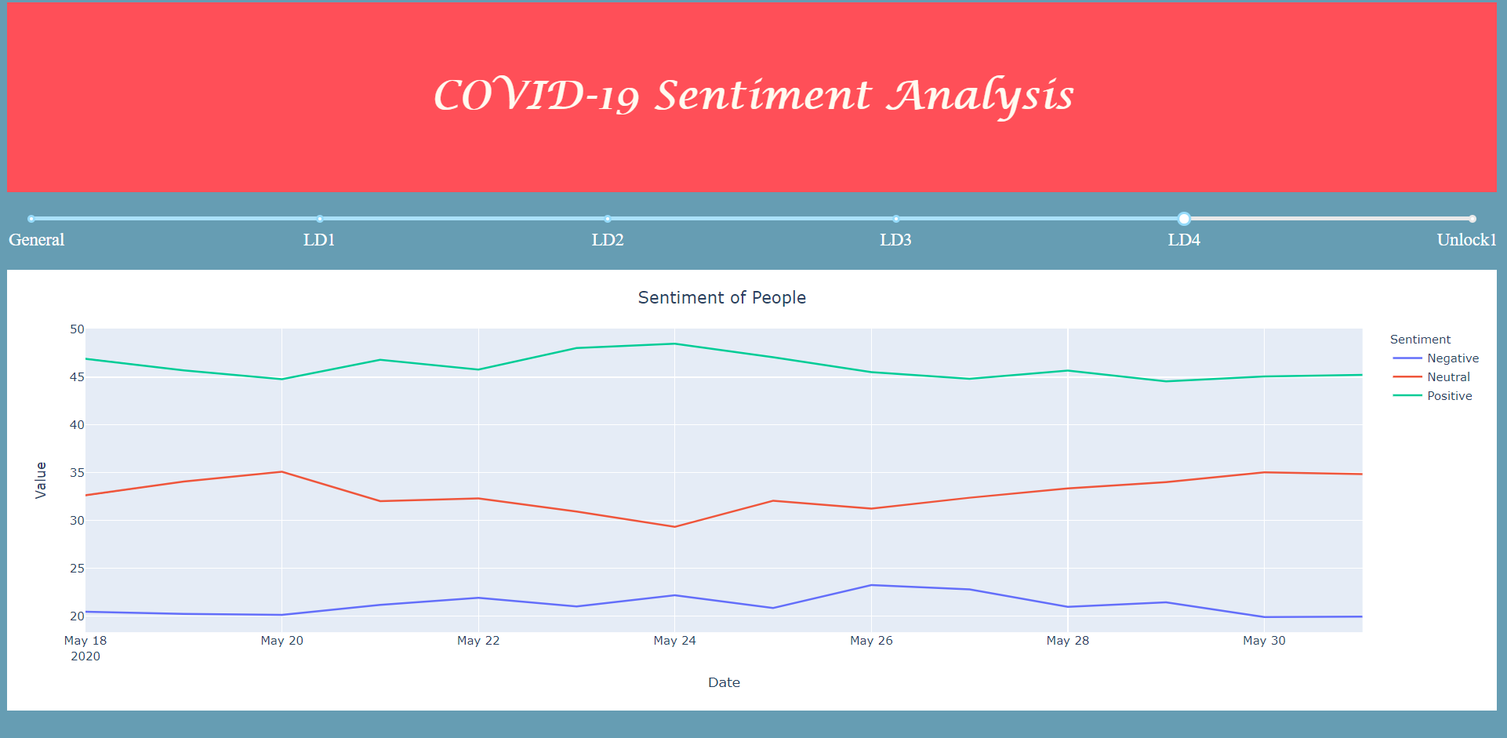
Sentiment Graph

Slide 8
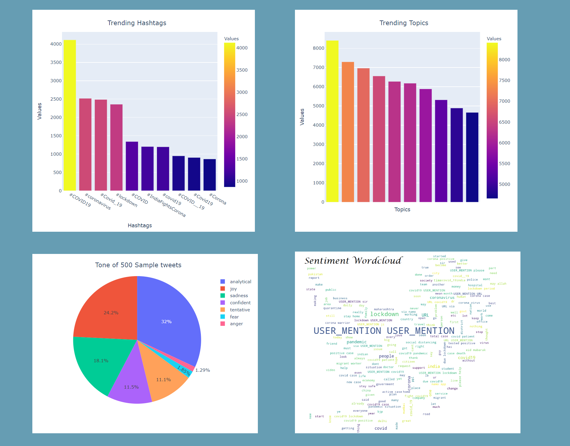
Trending Topics
&
Trending Hashtags
Data Tone
&
Wordcloud

Slide 9
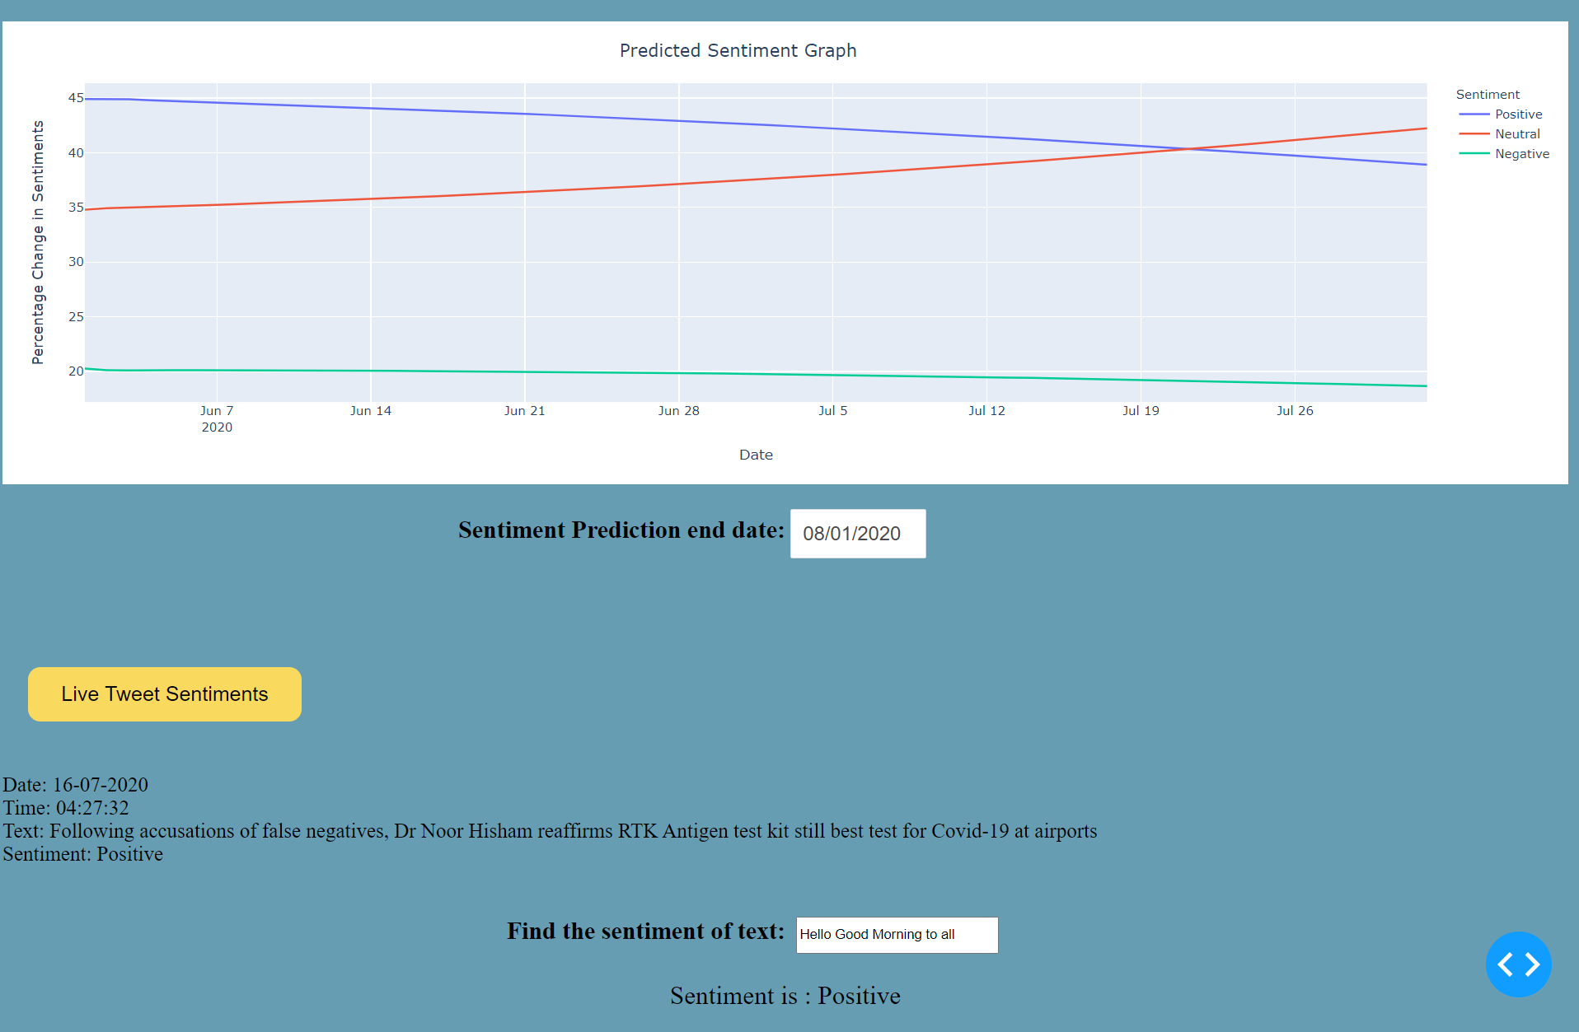
Prediction Graph
Live Sentiment Analysis

Slide 10
Conclusion
In the era where data rules the world, sentiment analysis provides an easier way of interpreting reactions to various events, decisions, products etc. This provides a unique and easy method to assess crowd reaction. We have seen how sentiment analysis can help the government in decision making in times of a pandemic. We also implemented Machine Learning approaches to sentiment analysis. We have also seen the visual implementation of the analysed data and have gone through the applications offered by the project.

Slide 11
Bibliography
Charming Data: Youtube Channel - https://youtu.be/hSPmj7mK6ng
Plotly Graphs - https://plotly.com/python/
Dash Documentation - https://dash.plotly.com/
Data Science Blogs - https://towardsdatascience.com/data-science/home
Pandas Guide - https://pandas.pydata.org/docs/user_guide/index.html
Stackoverflow
GeeksforGeeks

Slide 12
Thank You

